Slide 1


Project 159
Presented by Group 1

Slide 2

OUR TEAM
Anjali Sharma
Krishna Sameera Kota
Rumela Shankar Saha
Vedant Sharma
Vinaykumar Vasant Patil

Slide 3
Project Details
The OLIST STORE is an e-commerce business headquartered in Sao Paulo, Brazil. This firm acts as a single point of contact between various small businesses and the customers who wish to buy their products. In this project we were given multiple tables in CSV format and a schema depicting how these tables are connected. After connecting all the 8 tables, we analyzed the entire dataset. It contains multiple categorical and numerical columns and information about 100k orders made at multiple marketplaces between 2016 to 2018.
In this project we were provided with 5 KPI’s on which we have to work & provide answers & solutions by analyzing the dataset. During this project we worked in different phases & tools. Steps involved in this process were data cleaning using power query, data modeling for fact & dimensions table based on the basis of primary & foreign key relationship. By using MYSQL Workbench we found the answers for particular KPI by joining the tables using joins concept.

Slide 4
KPI 1
Weekday Vs Weekend (order_purchase_timestamp) Payment Statistics
Orders and Payment Value is more on weekdays as compared to weekends
Maximum sales, orders & customers are from Sao Paulo city during weekdays & weekends.
Credit cards are the most used payment type
Maximum orders are placed during March to August
Max. Payment are received for health and beauty category

Slide 5
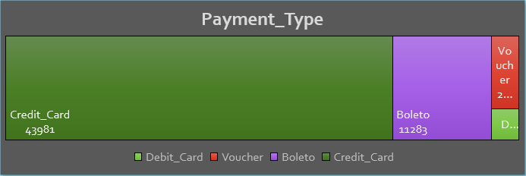
KPI 2
Number of Orders with Review score 5 and Payment_Type as Credit_card
Maximum payment value is done through credit card followed by boleto
Most of the orders received review score more than 4
Product category with the highest payment margin (79%) is home_comfort
Main reason customers preferred credit card is installment option
Most recommended products by customers have avg. review score more than 4

Slide 6
KPI 3
Avg. No. of days taken for order_delivered_customer_date for pet_shop
Avg. delivery days for Pet_shop is 11.31
Avg. review score for pet shop product category is 4.24 from 1710 orders
Max. orders for the pet shop category products are placed during April to August
In August delivery days went from 11 to 8 days, in turn rating was 4.38
Payment_value for pet_shop is 2,55,330.29
Payment_ type | Count of Orders | Count of Products | Payment_ Value | Price | Avg. rev. score | Avg. Del. Days
Credit card | 1342 | 621 | 2,05,294.90 | 1,74,933.70 | 4.23 | 11.37
Boleto | 311 | 231 | 40,214.39 | 33,645.90 | 4.33 | 11.34
Voucher | 66 | 60 | 5,402.39 | 5,720.20 | 4.35 | 11.56
Debit card | 32 | 32 | 4,418.61 | 3,876.42 | 3.63 | 10.50
TOTAL | 1710 | 719 | 2,55,330.29 | 2,14,315.41 | 4.24 | 11.31

Slide 7
KPI 4
Avg. Price and Payment_Values from customers of Sao Paulo City
Avg price and Avg. payment_value in Sao Paulo city is $107.53 $ 135.83 respectively
Sao Paulo city has a large customer base
The number of customers in Sao Paulo experienced substantial growth
Total price and payment values in Sao Paulo saw significant increases over the years
Contribution of Sao Paulo is more as compared to other cities in overall sales and payment value

Slide 8
KPI 5
Relationship between shipping days (order_delivered_customer_date - order_purchase_timestamp) Vs review scores
Avg. Shipping days is 12.50 and Avg. Review Score is 4.09
Longer delivery days significantly decrease the average review score
Review score improves when delivery days are less
Weight and surface area influence delivery days
Delivery costs generally increase with increase in delivery days

Slide 9
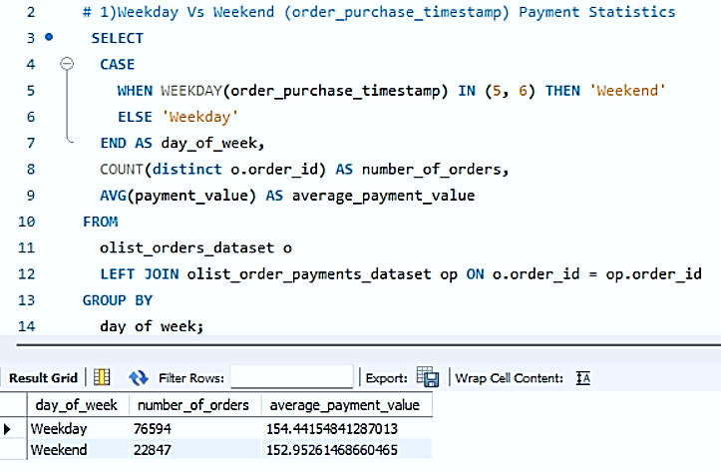
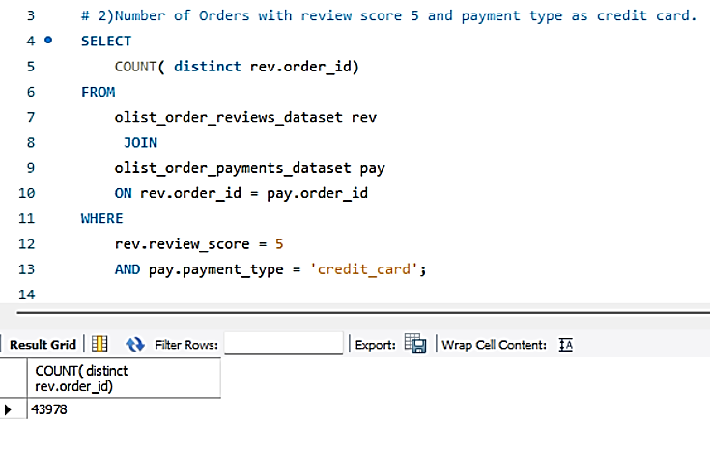
SQL Queries and OUTCOMES

Slide 10
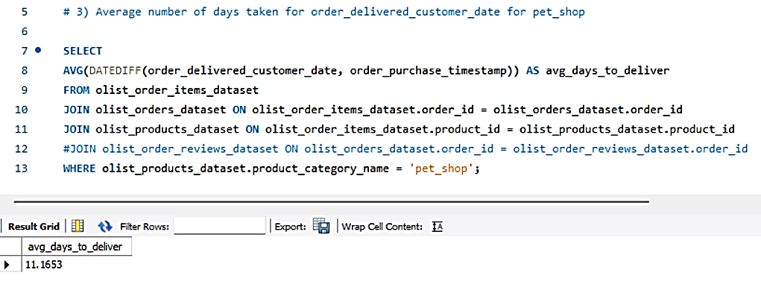
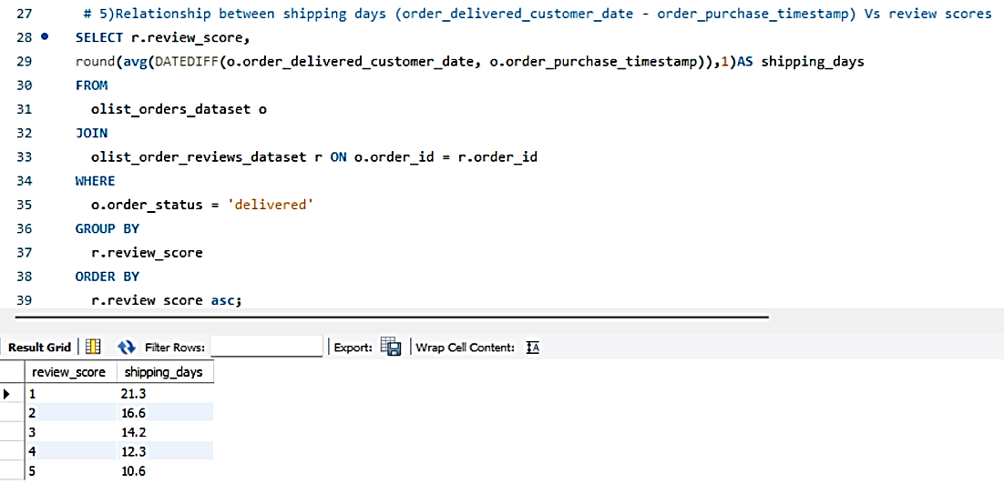
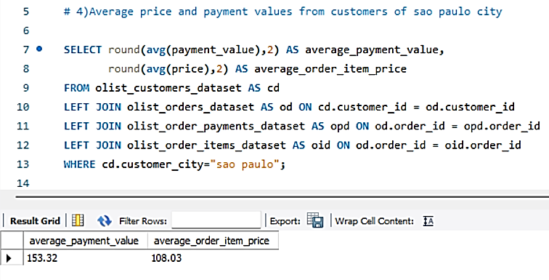
SQL Queries and OUTCOMES

Slide 11
CONCLUSIONS
Maximum orders are placed between March to August(60.38K) because of which sales during this month are higher($8.34M) which is 61.36% of total sales. Which shows that the store is performing well during this month.
Currently credit cards are the most preferred payment type by customers which contributes a major role in overall sales(78.44%). To improve sales & to promote other payment types, Olist Store can provide discounts & offers on other payment types.
Olist Store needs to work more during the last quarter to improve the sales as there are less orders placed during September to December months which also results in less average review score. Store needs to focus on advertisement & different offers on products during the period.
Maximum customer crowd is from Sao Paulo & Eastern side of the country as compared to other regions. To improve the sales in other regions stores need to focus on campaign & promotion in these regions.
After observing the comment section we got to know that Bed bath table, health beauty, sports leisure, furniture decor, computer accessories, housewares & watches gifts are the products which receive maximum of the recommendation from customers with average review score 4.08 which shows these are most demanding products among the customers.
From 5th KPI we can conclude that if sellers take longer days to deliver the product then customers provide less review score which shows it is one the factor that influences review score.
Sellers should improve on delivery days & should keep customers informed about status of delivery it will make time go much faster for customer and will create personalize experience because they know what's happening.

Slide 12
THANK YOU

